Slide 1
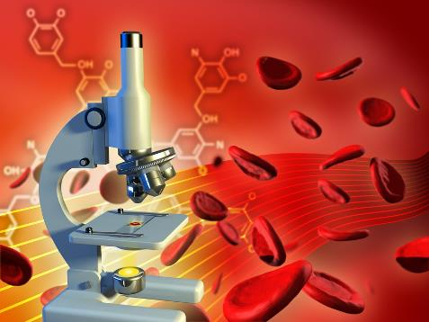
SANGELE
partea I
CLASA a X a
PROFESOR CUCOARA LAURA
LICEUL CU PROGRAM SPORTIV,, NICOLAE ROTARU” CONSTANTA

Slide 2
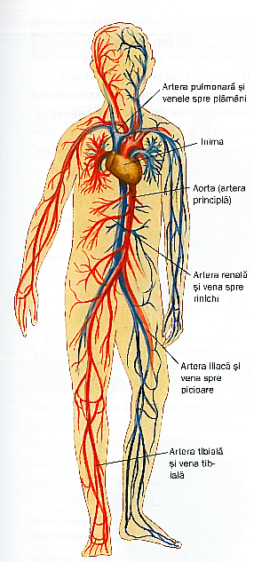
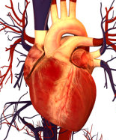
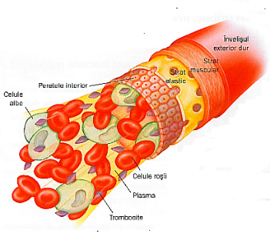
Sistemul circulator
CIRCULATIA
INIMA
VASE SANGVINE

Slide 3
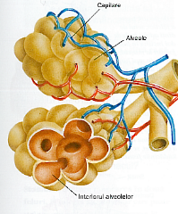
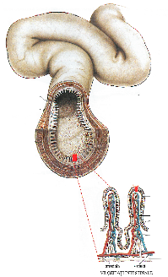
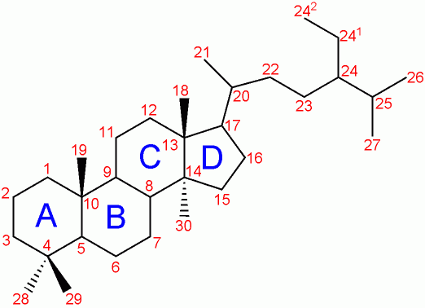
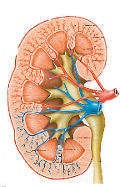
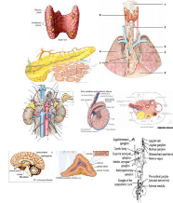
Transporta substantele nutritive la cellule.
Transporta gazele respiratorii (oxigenul si dioxidul de carbon )de la celule la plamani si invers.
FUNCTIILE SANGELUI:
Transporta toxinele (produsii metabolici celulari)
Transporta mesageri chimici
mesageri chimici (hormoni)

Slide 4
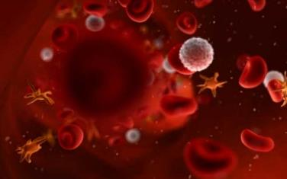
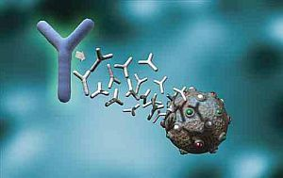
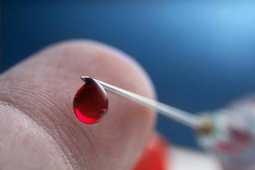
SANGELE
PARTICIPA LA APARAREA IMUNITARA
ASIGURA CONDITII FIZICO-CHIMICE CONSTANTE PENTRU CELULELE ORGANISMULUI

Slide 5
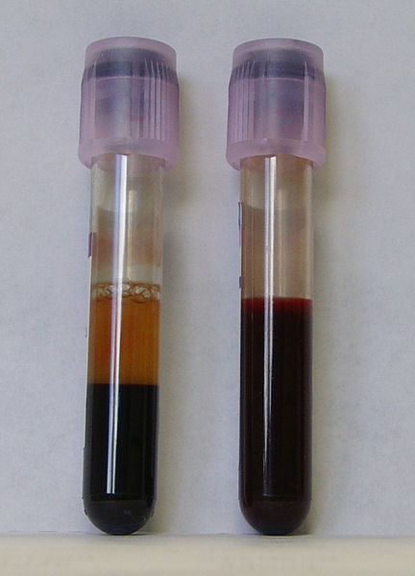
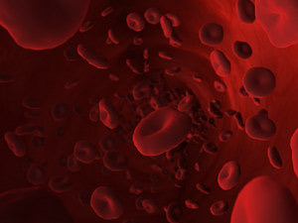
SANGELE
1.PLASMA SANGVINA (55-60%)
2. ELEMENTE FIGURATE:
(40-45 %)

Slide 6
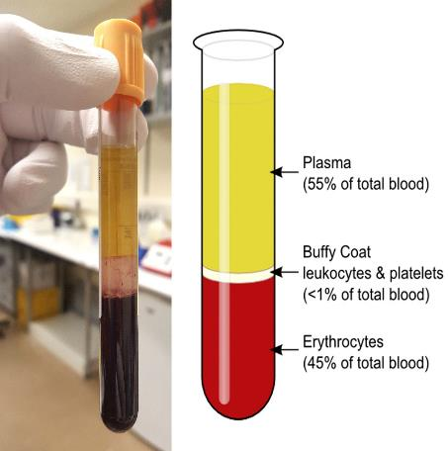
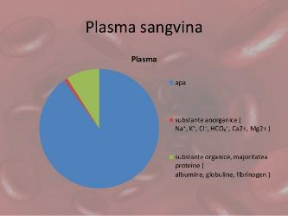
SANGELE
1.PLASMA SANGVINA (55-60%)
90% apa
9% substante organice
-1% saruri minerale

Slide 7
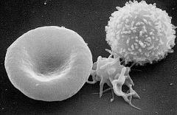
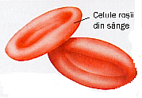
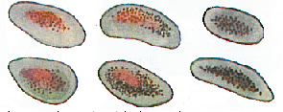
ELEMENTE FIGURATE
SANGVINE:
GLOBULE ROSII (HEMATII, ERITROCITE)
4,5-5 mil/mm3 de sange;transporta gazele respiratorii
GLOBULE ALBE (LEUCOCITE)
6-8 mil/mm3 de sange;rol imunitar
TROMBOCITE (PLACHETE SANGVINE)
150-300mii/mm3 de sange;rol in oprirea hemoragiilor

Slide 8
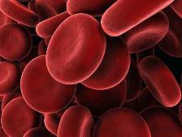
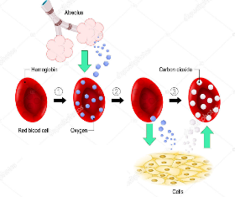
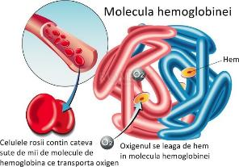
GLOBULE ROSII (HEMATII, ERITROCITE)
4,5-5 mil/mm3 de sange
TRANSPORTA GAZELE RESPIRATORII CU AJUTORUL HEMOGLOBINEI
O CANTITATE MICA DE GAZE RESPIRATORII CIRCULA IN STARE DIZOLVATA.

Slide 9
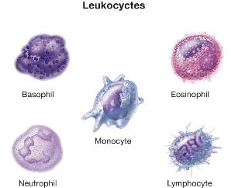
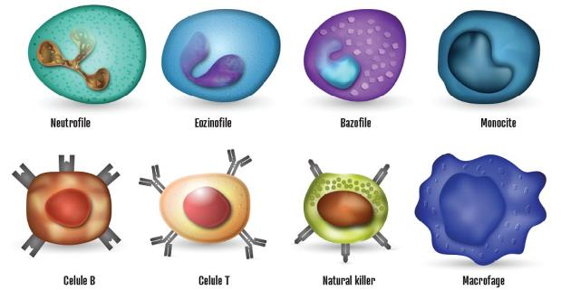
GLOBULE ALBE (LEUCOCITE)
6-8 mil/mm3 de sange;rol imunitar
ROL IN IMUNITATE

Slide 10
SURSE BIBLIOGRAFIE :
Stelica Ene, Sandu Gheorghita, Gheorghe Gamaneci, Manual de biologie, clasa a X-a, editura LVS CREPUSCUL, Ploiesti, 2005
Stefania Pelmus Giersch, Florina Amalia Toma,,, Elemente de biologie si patologie umana “, editura CD PRESS, Bucuresti, 2002
https://bioclinica.ro/pentru-pacienti/hematologie-1/sangele-compozitie-rol-analize-medicale-de-laborator
https://www.medlife.ro/site_storage/public/wp-content/uploads/2015/05/Inima-si-sistemul-circulator.jpg
https://adevarul.ro/locale/iasi/ce-elementele-figurate-sangele-uman-structurile-invizibile-rolul-decisiv-apararea-organismului-boli-1_579b464b5ab6550cb84df81c/index.html
https://leapsadesanatate.ro/2019/07/27/ce-este-homeostazia/
http://www.medtorrents.com/blog/diateze_hemoragice_componentul_vascular_in_hemostaza_rolul_trombocitelor_in_hemostaza/2017-03-18-1845
https://dozadesanatate.ro/ce-sunt-anticorpii-scurt-ghid-explicativ/
https://sl.wikipedia.org/wiki/Limfocit_T#/media/Slika:SEM_Lymphocyte.jpg
https://www.healthlinkbc.ca/health-topics/tp10281
https://chimistiicniv.wordpress.com/2016/02/22/hemoglobina/
https://glsa.ro/dotari-noi-pentru-unitatile-de-transfuzie-din-municipiu/
http://www.medtorrents.com/blog/activarea_limfocitelor_b_si_t_in_reactia_imuna/2016-07-21-122
https://www.realitatea.net/stiri/actual/rujeola-face-ravagii-in-romania-400-de-cazuri-noi-doar-in-ultima-luna-judetul-cel-mai-afectat_5dcc925c406af85273d67287
https://www.aspla.ro/trombocitele/
https://www.totuldespremame.ro/bebelusul-tau/alaptare/alaptare-de-succes-12-reguli-de-urmat
https://www.slideshare.net/rgrigoredaniel/circulatia
http://friskilaenglishcourse.blogspot.com/2015/12/team-work-interview-questions-with.html
https://clipartstation.com/fun-at-work-clipart-1/
https://educatie01.home.blog/2019/01/05/ce-este-mass-media/
http://www.sportclasic.ro/ro/Lotul-Romaniei-pentru-Europenele-de-scrima/
VIDEOCLIPURI:
https://www.youtube.com/watch?v=PzunOgYHeyg IMUNITATEA
https://www.youtube.com/watch?v=suED2J_A9WU COAGULAREA SANGELUI
https://blausen.com/ro/video/transfuzii-de-sange-si-de-trombocite/ TRANSFUZIA
https://www.youtube.com/watch?v=ERRfM9usYa8 SANGELE

